Slide 1


MJ COMPANY
Project
Name
Design and Implementation of a company System

Slide 2

Introduction
The Design and Implementation of a Company Network System aims to establish a reliable, scalable, and secure infrastructure that supports the company's daily operations and future growth. This project involves setting up a network across two branches, utilizing core and access switches, routers, VLANs for departmental segmentation, and secure connectivity through tunnels. The focus is on ensuring high availability, redundancy with HSRP, and security, while maintaining efficient communication between branches and providing secure, managed access to internal resources.

Slide 3


Agenda
Team Members | 3
Topology | 4
Objectives | 5
VLAN Configuration | 6
Inter-VLAN Routing | 7
DHCP Configuration | 8
HSRP Configuration | 9
WLC Configuration | 10
OSPF Configuration | 11
Switch Security Configuration | 13
EtherChannel Configuration | 14
GRE Tunnel | 15

Slide 4





Mahmoud Elsisi
Network Engineer
Mohamed Ebrahiem
Team members
Network Engineer
Ahmed Elmezien
Network Engineer
Seif Zanaty
Network Engineer
Abdelrahman Kadry
Network Engineer
Back to Agenda

Slide 5
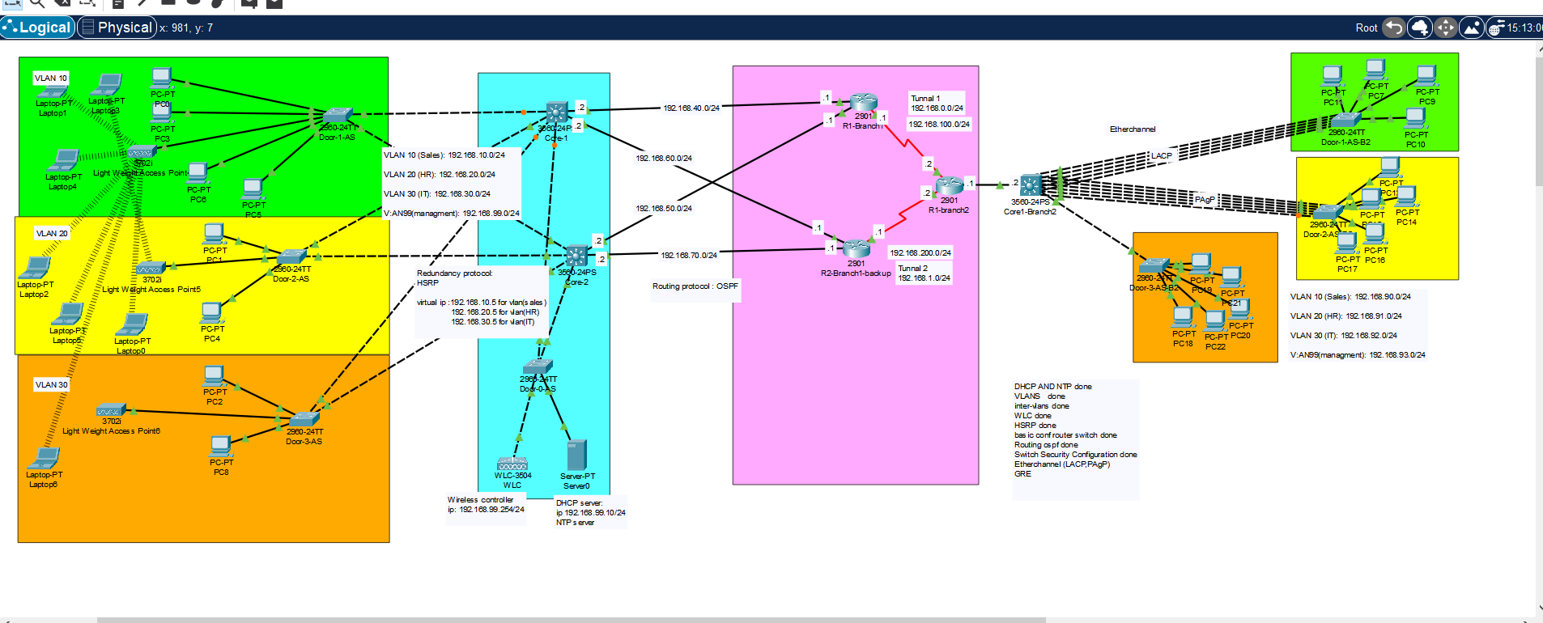
Topology

Slide 6
VLAN Configuration
Objectives
Inter-VLAN Routing
DHCP Configuration
HSRP Configuration
WLC Configuration
OSPF Configuration
Switch Security Configuration
EtherChannel Configuration
Back to Agenda
GRE Tunnel

Slide 7






VLAN Configuration
Create a VLAN
Switch(config)# vlan 10 Switch(config-vlan)# name HR Switch(config-vlan)# exit
A VLAN (Virtual Local Area Network) allows you to segment a network into smaller, isolated sections for better traffic management, security, and scalability.
Assign a port to the VLAN
Switch(config)# interface rangeGigabitEthernet0/1 - 10 Switch(config-if-range)# switchport mode access Switch(config-if-range)# switchport access vlan 10
Back to Agenda

Slide 8
Create a sub-interface for each VLAN on a core switch
Inter-VLAN Routing
CoreSwitch(config)# interface vlan10
CoreSwitch(config-subif)# ip address 192.168.10.1 255.255.255.0
CoreSwitch(config-subif)# exit
Inter-VLAN routing allows devices in different VLANs to communicate with each other. This can be achieved using a Layer 3 switch (preferred) or a router.
Enable Routing Between VLANs
CoreSwitch(config)# ip routing
Back to Agenda

Slide 9
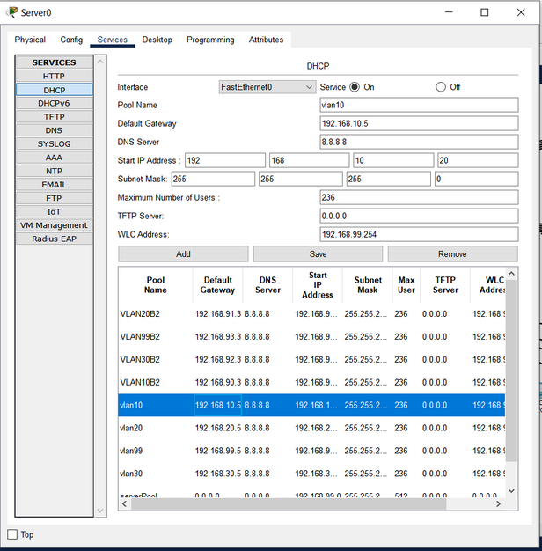
Create the DHCP pool for each vlan.
Exclude IP addresses from the pool
DHCP Configuration
put default gateway and DNS server
Dynamic Host Configuration Protocol (DHCP) automates the process of assigning IP addresses and other network configuration parameters to devices on a network.
Back to Agenda

Slide 10
Configure HSRP on each core switch interface vlan
HSRP Configuration
interface Vlan10
ip address 192.168.10.1 255.255.255.0
standby 10 ip 192.168.10.5
HSRP (Hot Standby Router Protocol) is a Cisco proprietary redundancy protocol that allows multiple routers to work together to provide network resilience and high availability.
Set a higher priority on the primary core switch
standby 10 priority 110
standby 10 preempt .
Back to Agenda

Slide 11
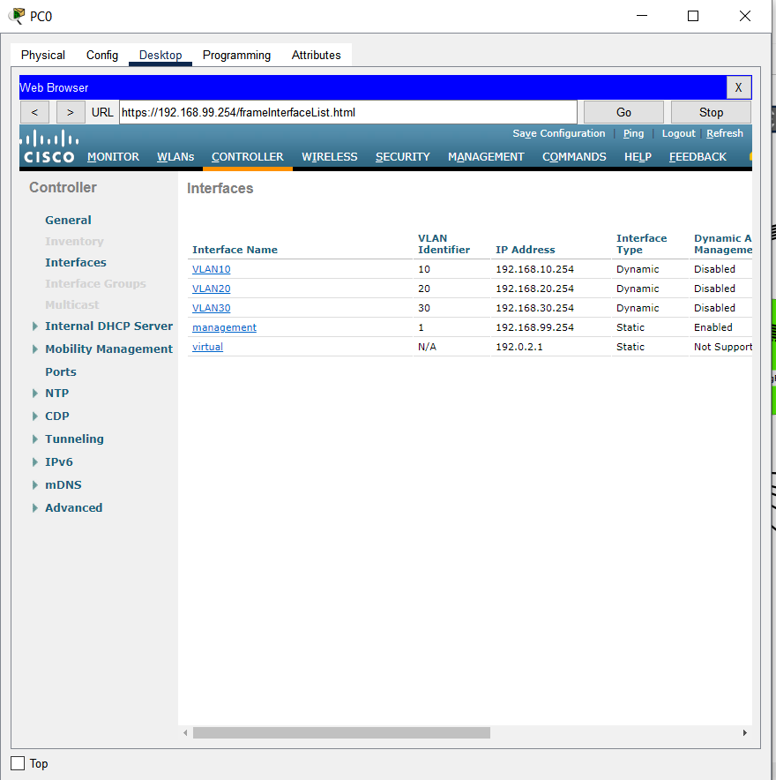
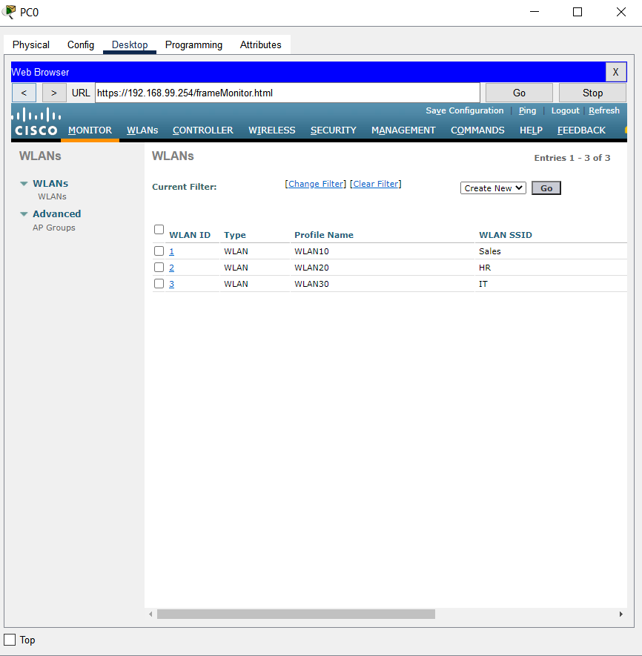
Configure the management interface on the Wireless LAN Controller (WLC).
WLC Configuration
Create interface for each vlan and configure a new WLAN.
A Wireless LAN Controller (WLC) is a central device that manages multiple access points (APs) in a network, providing features like wireless security, configuration, and monitoring
Back to Agenda

Slide 12

Enter OSPF configuration mode
router ospf 1
OSPF Configuration
Assign network statements
Open Shortest Path First (OSPF) is a link-state routing protocol used to find the best path for packets as they pass through a set of connected networks.
network 192.168.40.0 0.0.0.255 area 0
network 192.168.50.0 0.0.0.255 area 0
network 192.168.100.0 0.0.0.255 area 0
Set router ID (optional)
router-id 1.1.1.1
Back to Agenda

Slide 13
Create a Secure Trunk
Switch(config)# interface GigabitEthernet0/1
Switch(config-if)# switchport mode trunk
Switch(config-if)# switchport nonegotiate
Switch(config-if)# switchport trunk native vlan 99
Secure Unused Switchports
Switch Security Configuration
Switch(config)# interface GigabitEthernet0/2 Switch(config-if)# shutdown
Implement Port Security
Switch(config)# interface GigabitEthernet0/1 Switch(config-if)# switchport port-security
Switch(config-if)# switchport port-security maximum 1
Switch(config-if)# switchport port-security violation re Switch(config-if)# switchport port-security mac-address sticky
Switch security is crucial in protecting the network from unauthorized access and attacks.
Configure Rapid PVST PortFast and BPDU Guard
Switch(config)# interface range GigabitEthernet0/1 - 24
Switch(config-if-range)# spanning-tree portfast
Switch(config-if-range)# spanning-tree bpduguard enable
Back to Agenda

Slide 14
Enter Interface Range Mode
Switch(config)# interface range GigabitEthernet0/1 - 5
EtherChannel Configuration
Configure EtherChannel Mode
Switch(config-if-range)# switchport mode trunk Switch(config-if-range)# channel-group 1 mode active Switch(config-if-range)# exit
EtherChannel is a technology that allows you to bundle multiple physical Ethernet links into a single logical link to increase bandwidth and provide redundancy.
Configure the EtherChannel interface
Switch(config)# interface Port-channel1
Switch(config-if)# switchport mode trunk
Switch(config-if)# ip address 192.168.1.1 255.255.255.0 Switch(config-if)# exit
Back to Agenda

Slide 15
Create the tunnel interface
R1-Branch1(config)# interface Tunnel0
GRE Tunnel
GRE tunnels are used to encapsulate packets from one network protocol inside packets of another protocol, facilitating the creation of a virtual point-to-point link between remote sites.
Assign an IP address
ip address 192.168.0.1 255.255.255.0
Set the tunnel source and destination
tunnel source Serial0/3/0 tunnel destination 192.168.100.2
Back to Agenda

Slide 16
THANK YOU

